Slide 1
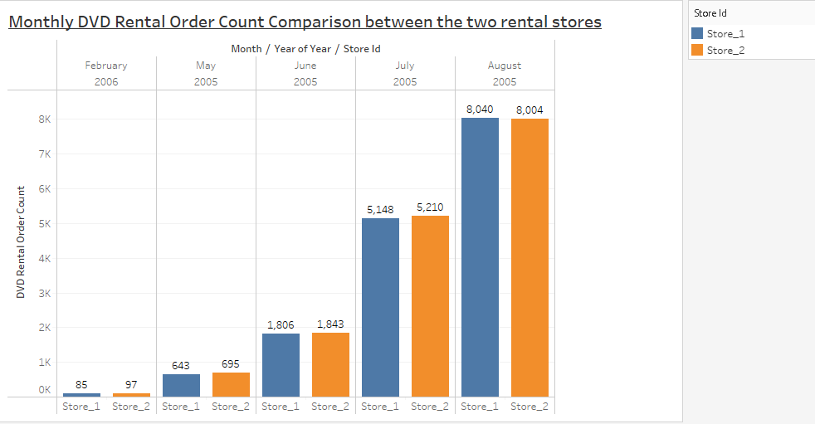
Rental Store’s Orders Comparison
Description:
Pick orders for both stores was in August 2005 while the lowest orders count was recorded in February 2006.
In General, the two stores had close range total orders count when compared in each month.
Notes:
/*SLIDE 1
finding out how the two stores compare in their count of rental orders during every month for all the years we have data for.
*/
WITH rent_count AS (
SELECT DISTINCT DATE_PART('year', rt.rental_date) AS year, DATE_PART('month', rt.rental_date) AS month, sf.store_id,
COUNT(DATE_PART('month', rt.rental_date)) OVER (PARTITION BY sf.store_id ORDER BY DATE_PART('month', rt.rental_date)) AS count
FROM staff sf
JOIN store st
ON sf.store_id = st.store_id
JOIN rental rt
ON sf.staff_id = rt.staff_id)
SELECT rc.year,
CASE
WHEN rc.month = 1 THEN 'Jan'
WHEN rc.month = 2 THEN 'Feb'
WHEN rc.month = 3 THEN 'Mar'
WHEN rc.month = 4 THEN 'Apr'
WHEN rc.month = 5 THEN 'May'
WHEN rc.month = 6 THEN 'Jun'
WHEN rc.month = 7 THEN 'Jul'
WHEN rc.month = 8 THEN 'Aug'
WHEN rc.month = 9 THEN 'Sep'
WHEN rc.month = 10 THEN 'Oct'
WHEN rc.month = 11 THEN 'Nov'
WHEN rc.month = 12 THEN 'Dec'
END AS month,
rc.store_id,
rc.count
FROM rent_count rc;

Slide 2
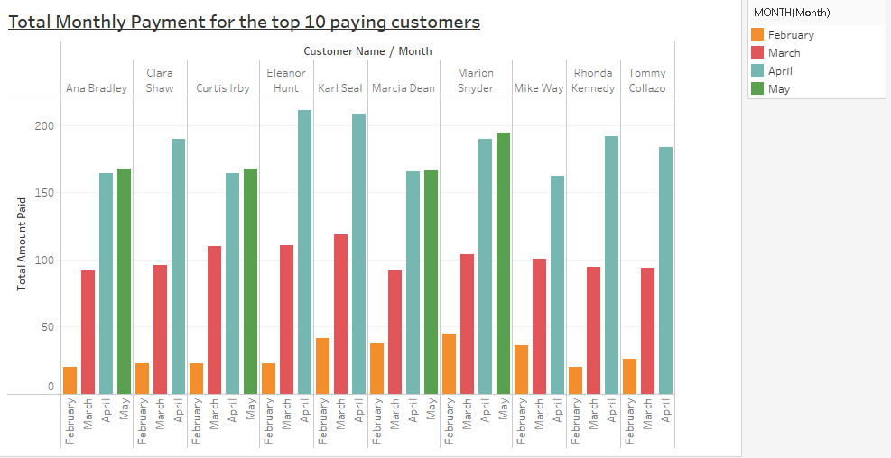
Payment Insight for Top 10 paying customers
Description:
The total monthly payment made by all top 10 customers was at it’s lowest in the month of February while pick payment for most of the customers under review was in April.
Eleanor Hunt is the customer with the highest payment difference across two successive month with an increase of 100.8 between March and April.
Notes:
/*SLIDE 2
For each of the top 10 paying customers, I would like to find out the difference across their monthly payments during 2007.
query to compare the payment amounts in each successive month.*/
WITH topC AS (
SELECT DISTINCT py.customer_id cx_id, CONCAT(cs.first_name, ' ', cs.last_name) fullname, DATE_TRUNC('month', py.payment_date) pay_month,
COUNT(DATE_TRUNC('month', py.payment_date)) OVER (PARTITION BY py.customer_id ORDER BY (DATE_TRUNC('month', py.payment_date))) payment_count,
SUM(py.amount) OVER (PARTITION BY py.customer_id ORDER BY (DATE_TRUNC('month', py.payment_date))) total_amt_paid
FROM payment py
JOIN customer cs
ON py.customer_id = cs.customer_id
WHERE py.customer_id IN (SELECT top10.cx_id
FROM(
SELECT py.customer_id cx_id,
SUM(py.amount)
FROM payment py
JOIN customer cs
ON py.customer_id = cs.customer_id
GROUP BY 1
ORDER BY 2 DESC
LIMIT 10) AS top10)
ORDER BY 1)
SELECT topC.fullname, topC.pay_month, topC.total_amt_paid,
LEAD(topC.total_amt_paid) OVER (PARTITION BY topC.cx_id ORDER BY topC.fullname),
COALESCE((LEAD(topC.total_amt_paid) OVER (PARTITION BY topC.cx_id ORDER BY topC.fullname) - topC.total_amt_paid ), 0) monthly_diff
FROM topC
ORDER BY 5 DESC;

Slide 3
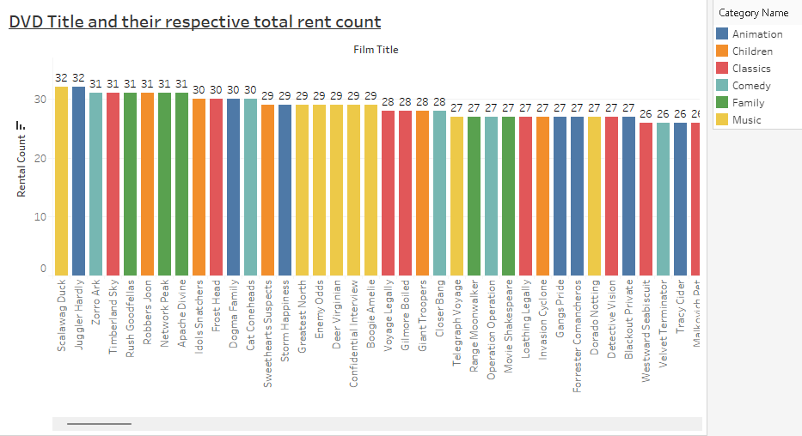
Rental Count for each DVD
Description:
The DVDs with highest rent count are Scalawag Duck and Juggler Hardly having 32 rent count.
The graph shows that high DVD rental count is seen in the Music DVD category.
Notes:
/*SLIDE 3
Insight into the movies that families are watching.
The following categories are considered family movies: Animation, Children, Classics, Comedy, Family and Music.
*/
WITH filmCat AS (
SELECT fc.film_id film_id, fc.category_id category_id, c.name AS name
FROM film_category fc
JOIN category c
ON fc.category_id = c.category_id
WHERE c.name IN ('Animation', 'Children', 'Classics', 'Comedy', 'Family', 'Music')),
rentDate AS (
SELECT i.film_id film_id, r.rental_date rental_date
FROM rental r
JOIN inventory i
ON r.inventory_id = i.inventory_id)
SELECT DISTINCT f.title film_title, fc.name AS category_name, COUNT(rd.rental_date) OVER (PARTITION BY f.title ORDER BY fc.name ASC) AS rental_count
FROM film f
JOIN filmCat fc
ON f.film_id = fc.film_id
JOIN rentDate rd
ON f.film_id = rd.film_id
ORDER BY 2,1;

Slide 4
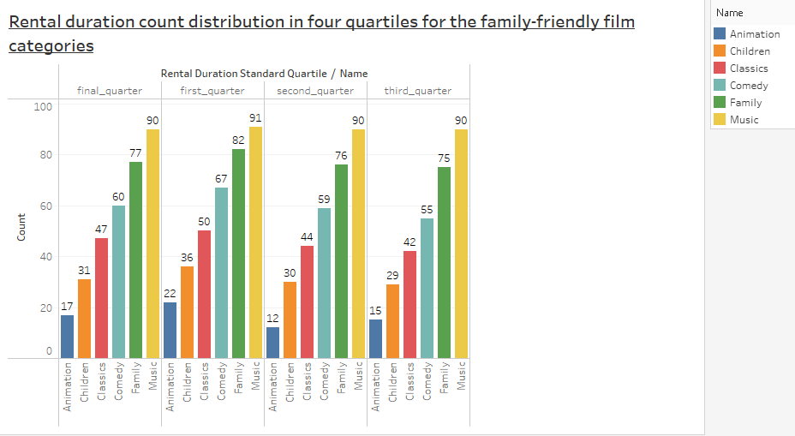
Rental duration distribution in categories
Description:
From the graph high rental duration is seen for Music category as the record count in each of the quartile is at pick for the category.
Animation had a low count on rental duration as seen from the graph across the four quartiles.
Notes:
/*SLIDE 4
Four quartiles insight into the family-friendly film category,
and the corresponding count of movies within each combination of film category for each corresponding rental duration category.
*/
WITH filmCat AS (
SELECT fc.film_id film_id, fc.category_id category_id, c.name AS name
FROM film_category fc
JOIN category c
ON fc.category_id = c.category_id
WHERE c.name IN ('Animation', 'Children', 'Classics', 'Comedy', 'Family', 'Music')),
quart AS (
SELECT fc.name AS name, NTILE(4) OVER (ORDER BY f.rental_duration) AS standard_quartile
FROM film f
JOIN filmCat fc
ON f.film_id = fc.film_id)
SELECT DISTINCT q.name AS name, q.standard_quartile, COUNT(q.standard_quartile) OVER (PARTITION BY q.standard_quartile ORDER BY q.name ASC) AS count
FROM quart q
ORDER BY 1, 2;

